Slide 1



SOLVEIT
A Peer-to-Peer Learning Platform for Kathmandu University
PRESENTED BY:
Aryan Thagunna
Sakar Maharjan
Pukar Adhikari
Aryan Mahato

Slide 2

02/17
01
Built using React & Tailwind CSS for the frontend and Flask for the backend
What is SolveIt?
02
Features like subject-specific feeds, file uploads, and customizable tags
A university-focused Q&A platform that allows students to ask, answer, and collaborate on academic questions, inspired by Stack Overflow.
03
Fosters collaborative academic environment

Slide 3
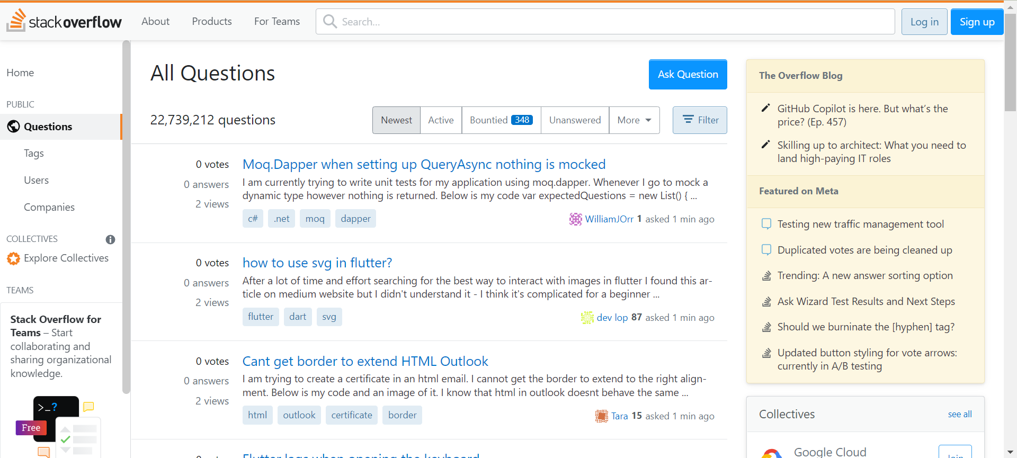
03/17
Stack Overflow as an inspiration

Slide 4
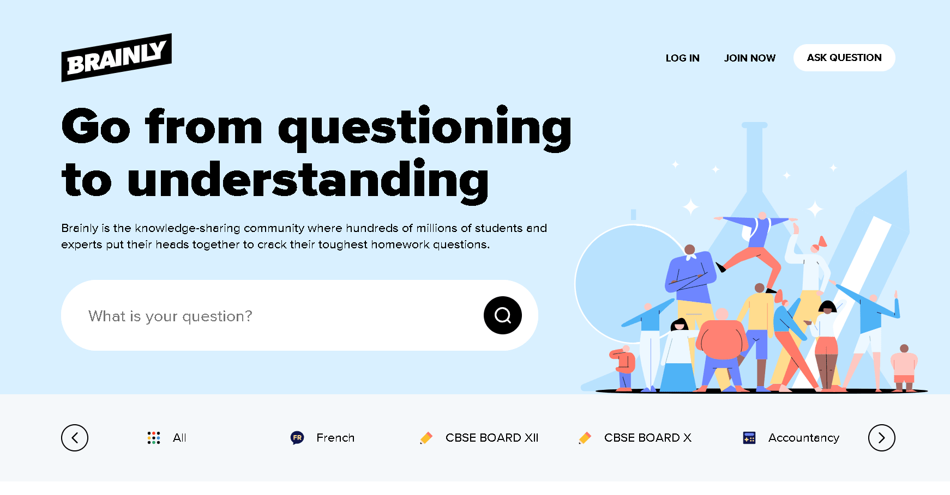
04/17
Brainly as an inspiration

Slide 5


05/17
Project Scope
01 | University-focused Q&A Platform
02 | Goals and company vision
03 | Customizable Tags
04 | Collaborative Answering
05 | File Upload Support
06 | Students can answer questions with file attachments
07 | User Profiles

Slide 6

06/17
Objectives and Goals
Goal # 1
Goal # 2
Goal # 3
Provide a platform where students can help each other by asking and answering specific course-related questions
Support students who may have missed lectures or need further clarification on topics through community answers.
Build a searchable archive of academic questions and answers for future reference.

Slide 7

Initial Struggles with C++
07/17
The transition from an initial C++/Qt framework to a React.js, Flask, and SQLite stack was crucial for SolveIt's web-based deployment and functionality
Web Deployment Challenges
Primarily designed for desktop applications, lacking native web support.
Limited Web Features
No built-in support for routing, HTTP handling, or user sessions.
Time Constraints
Required extensive low-level coding for web functionalities

Slide 8



08/17
Design & Implementation
Frontend : React + Tailwind CSS
Dynamic, component-based frontend for a responsive user experience
Backend : Flask
Lightweight backend for rapid prototyping and REST API creation

Slide 9
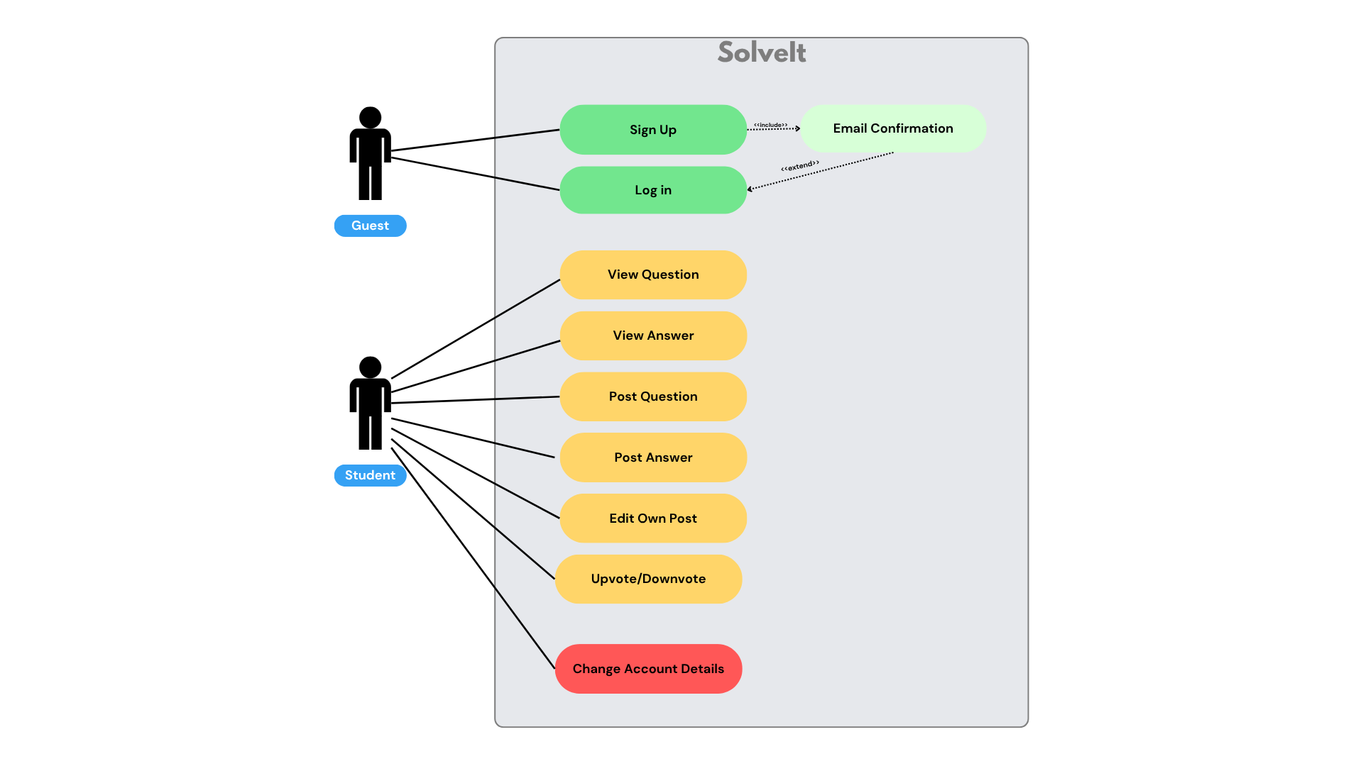
Figure: Use Case Diagram

Slide 10
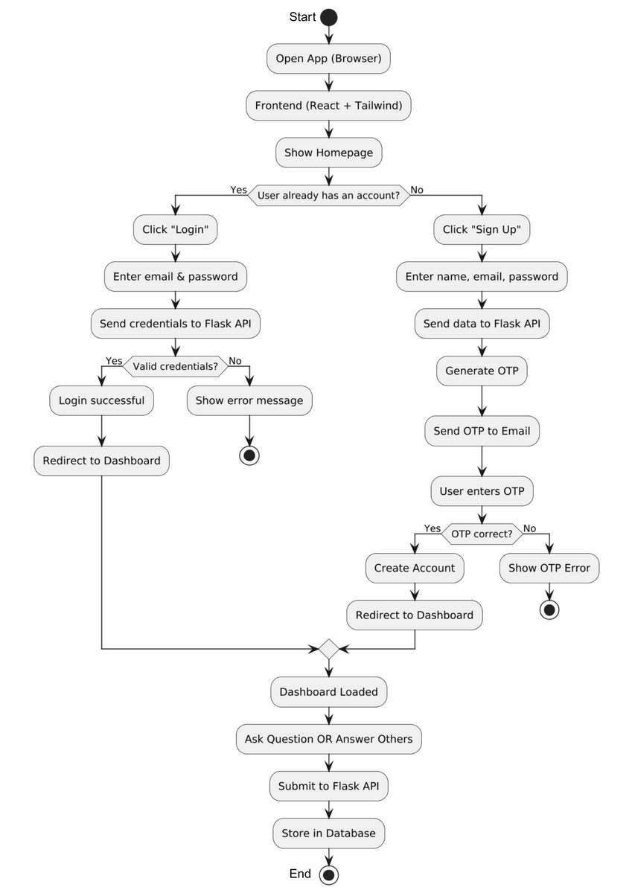
Figure: Flowchart

Slide 11

Key Features and Functionality
11/17
Students can easily post new questions with detailed descriptions.
Students can manage their information and select tags based on subjects or university courses, tailoring their feed.
Supports university course-specific tagging to ensure content relevance and easy discoverability.
Supports university course-specific tagging to ensure
content relevance and easy discoverability.

Slide 12

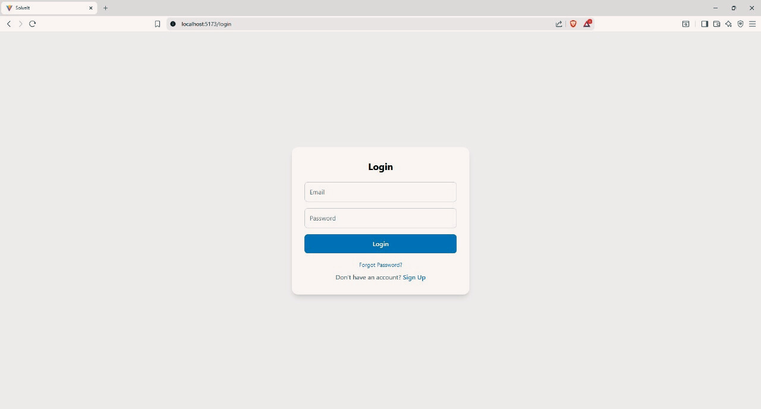
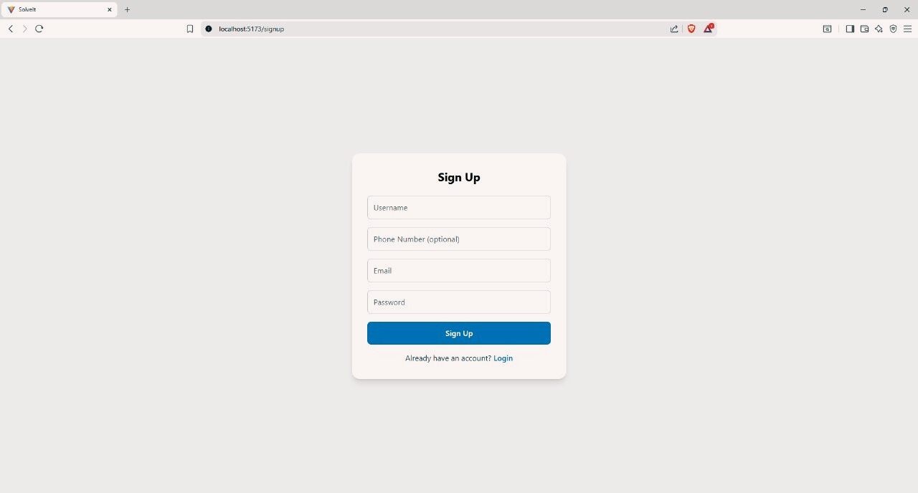
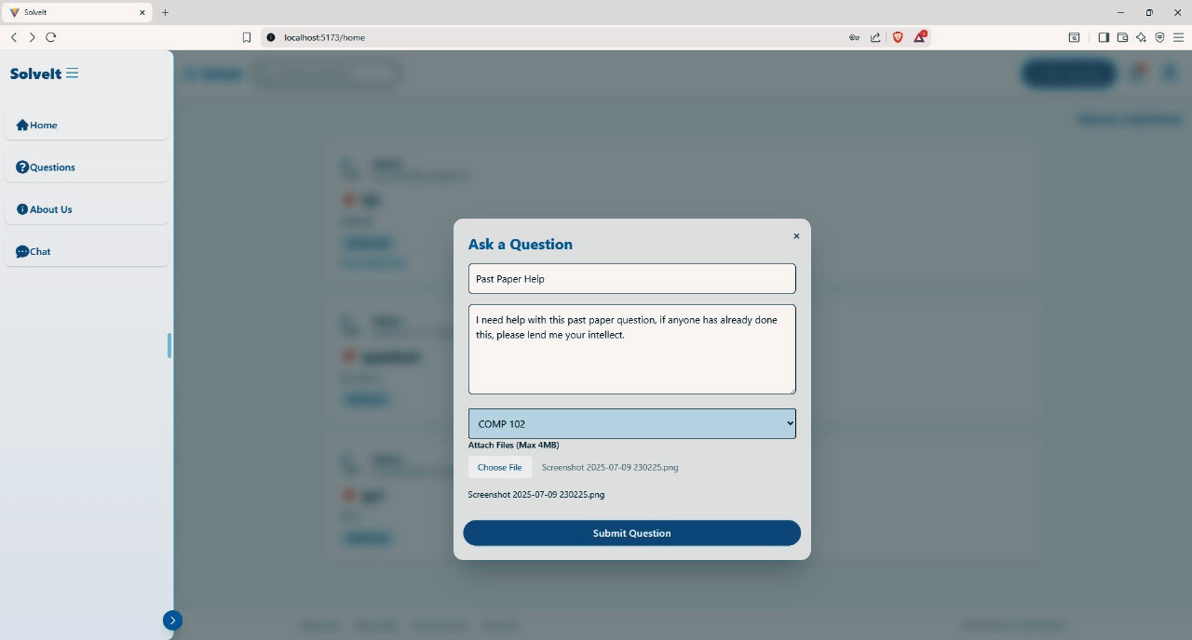

Slide 13
Walkthrough

Slide 14



Limitations and Challenges
Restricted User Base
No Direct Communication
Limited Search Functionality
Provide a platform where students can help each other by asking and answering specific course-related questions
Absence of chat or direct messaging restricts user engagement to public threads, limiting immediate, private collaboration.
Lack of a global search bar requires manual browsing, hindering efficient content discovery for users
14/17

Slide 15
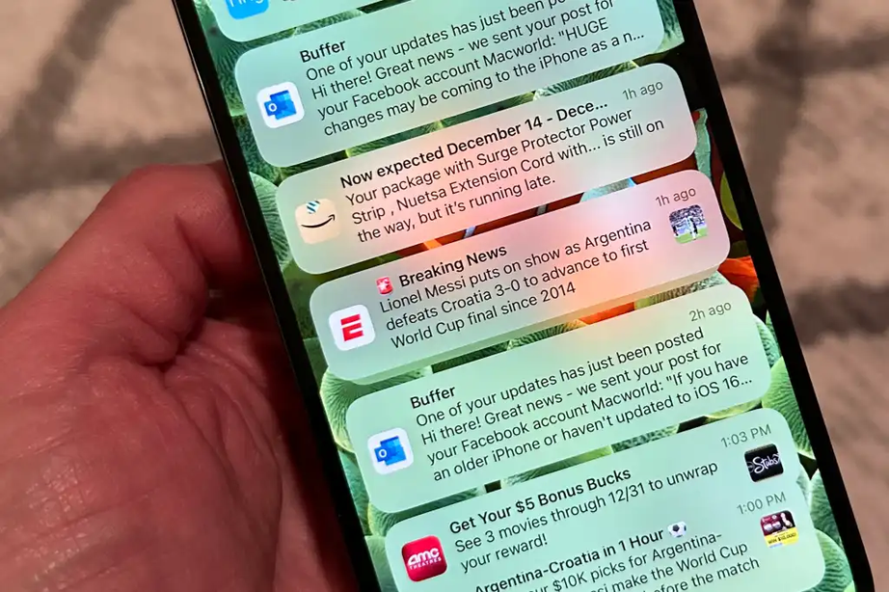
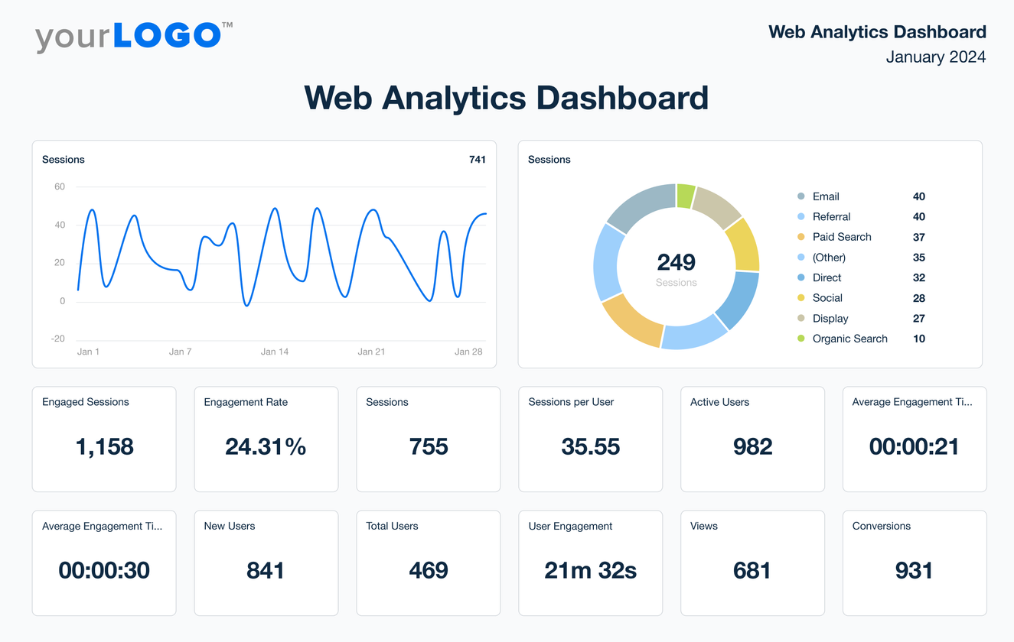

Future Enhancements
15/17
Notification System
Analytics
Answer Validation by Instructors

Slide 16

Conclusion
16/17
SolveIt successfully localizes the collaborative knowledge-sharing model of global platforms like Stack Overflow and Brainly for our university community. The platform now enables subject-specific discussions and file sharing among peers—fully functional and ready to support student-centric academic collaboration

Slide 17
THANK YOU

